Slide 1
Copyright © 2014 by Software Craftsmanship Guild.
All rights reserved. No part of these materials may be reproduced, distributed, or transmitted in any form or by any means, including photocopying, recording, or other electronic or mechanical methods, without the prior written permission of the Software Craftsmanship Guild. For permission requests, write to the Software Craftsmanship Guild, addressed “Attention: Permissions Coordinator,” at the address below.
Software Craftsmanship Guild
526 S. Main St, Suite 609
Akron, OH 44311

Slide 2
Intro to Data Manipulation Language (DML)
Software Craftsmanship Guild

Slide 3
Lesson Goals
Learn how to insert, update, and delete information from database tables

Slide 4
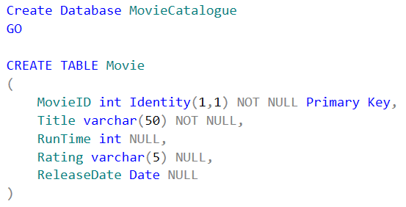
First, let’s make a sandbox
Notes:
Remember to put a use MovieCatalogue

Slide 5
Inserting Data
Every table starts out empty (of course). The only way to populate a table is to insert data into the table
When we insert data we typically provide a list of columns we want to populate followed by the list of values we would like to put into the columns
Do note that the order matters, if you don’t list the values in the same order as the columns at best you will get an error and at worst the data will go into the wrong spot!

Slide 6
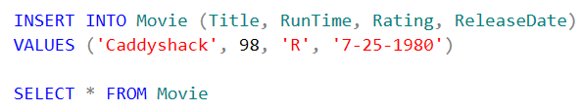
Inserting a Movie
Notice we don’t put the MovieID into the list. It is an identity field so the database will create the id key. If we tried to pass it a value it would fail.

Slide 7
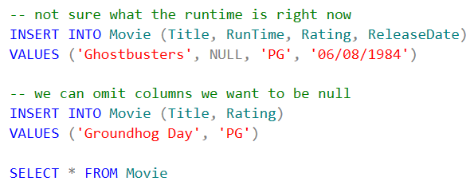
Null Columns
Columns marked as null are optional, and thus do not need to be specified in the insert statement. Both of these inserts are valid:

Slide 8
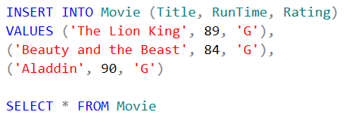
Row Constructors
This only works in SQL 2008 or higher

Slide 9
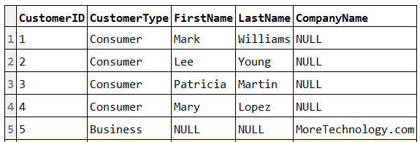
Lab - Create a table Customer
ColumnName | Type | Attribute
CustomerID | Int | Primary Key
CustomerType | Varchar(30) | Not null
FirstName | Varchar(20) | Null
LastName | Varchar(30) | Null
CompanyName | Varchar(30) | Null
Add this data

Slide 10
Updating Data
When we want to change existing data in the database we use the UPDATE keyword.
We must be EXTRA careful when writing update statements, as we will see in the following example

Slide 11

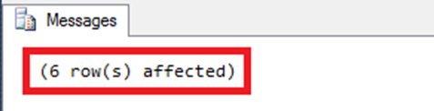
A bad update
Let’s say we found the runtime of Ghostbusters to be 107 minutes…
Oh noes!

Slide 12
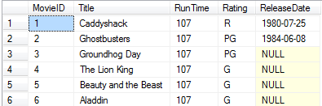
Hope we have a backup…

Slide 13
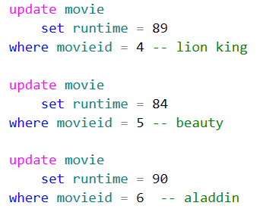
Let’s fix the data properly, specifying the key in a where clause

Slide 14
We can write complex where statements
Just FYI, we don’t have to update on just the primary key, we could update all customers with a certain zip code to a new zip code for example.
Protip: Always build a select statement to select the data you want to update first and make sure it looks right before doing the update. The more rows that will be updated, the more careful you should be.

Slide 15
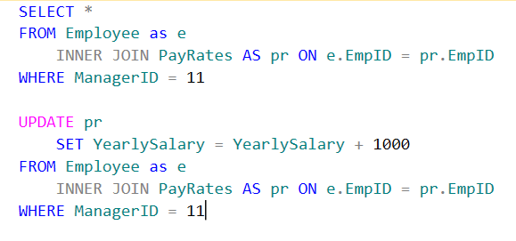

Giving Sally’s Employees A Raise
We can update data in one table based on the criteria in another table. It’s a slightly more complicated query.
As an example, let’s give Sally’s (EmployeeID = 11) employees a $1,000 raise.
My SQL

Slide 16
Notice that 6 rows were affected…
But only the two employees with a YearlySalary got the raise
We can not do math on a null
Anything compared to null is false
Any math on a null is null

Slide 17
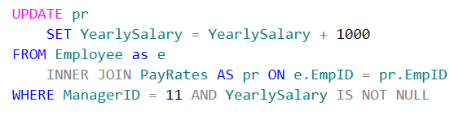
A better way to write that query

Slide 18
Lab Exercises
Sally (employeeID 11) is getting married, change her last name to Green
All the employees in the Spokane location are becoming contractors, update their status field to External
The location for Seattle has a typo, update the street field to read 111 1st Ave
A new policy requires that grants for employees in Boston be made for $20,000. There are two Boston records which aren’t set to $20,000. Please fix them!

Slide 19

Deleting Data
Deletes are similar to updates in that if you don’t specify a where filter the entire table will be deleted
SQL Server will not allow you to delete a row that is referenced by another table as its foreign key. You must delete all the relations first, then delete the primary row

Slide 20
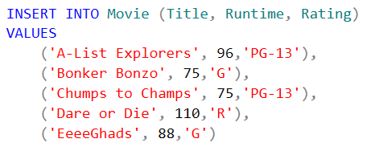
Now we need to put data back in…

Slide 21

Delete only long movies

Slide 22
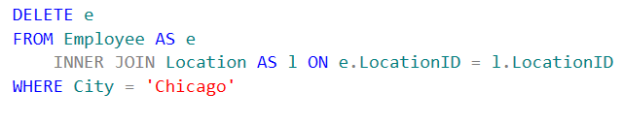
Multiple Table Deletes
There are no employees in Chicago, so this is a safe statement to run

Slide 23
Lab Exercises
We are moving our G movies to a kids website, delete all the G rated movies
SWCCorp is not teaching long classes anymore for management, delete all records where the duration is more than 20 hours

Slide 24
Fin
Next up- Table Maintenance!

